Slide 1
Severity Analysis
For the Cyber Attacks
M. Ishara Sampath

Slide 2
INTRODUCTION
In an era dominated by digital transformation, the omnipresence of cyber threats has become a critical concern for organizations across the globe. As the frequency and sophistication of cyber-attacks continue to escalate, understanding the severity of these incidents becomes paramount for effective cyber security strategies. This project focuses on the development of a machine learning (ML) model for severity analysis of cyber-attacks, aiming to provide organizations with a proactive defense mechanism against the evolving landscape of digital threats

Slide 3
01
02
03
Dataset
Understanding the data
Data Visualizations
04
05
Classification
Outcome

Slide 4
01
Dataset
More than 40,000 latest data related to the cyber security attacks over the world

Slide 5
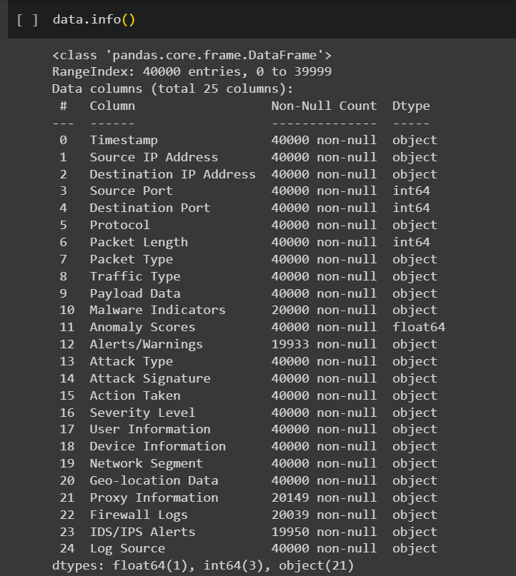
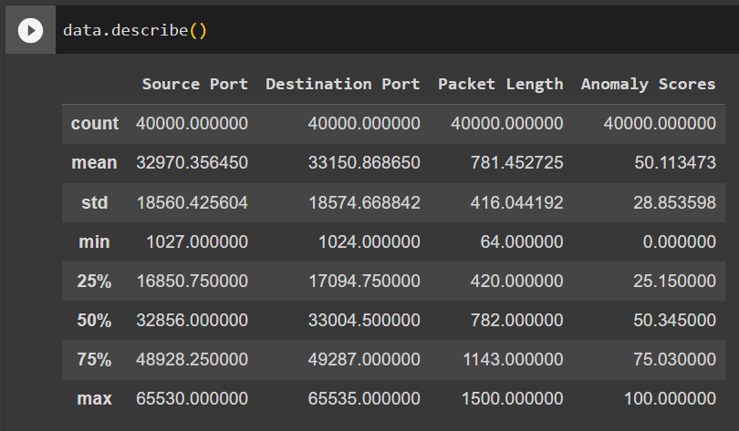
Understanding the data
02

Slide 6

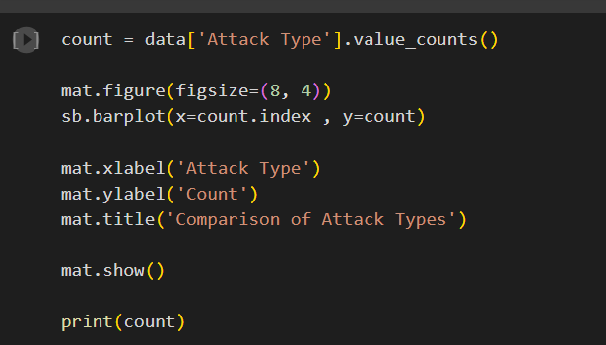
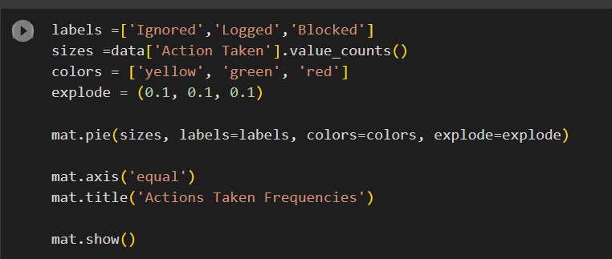
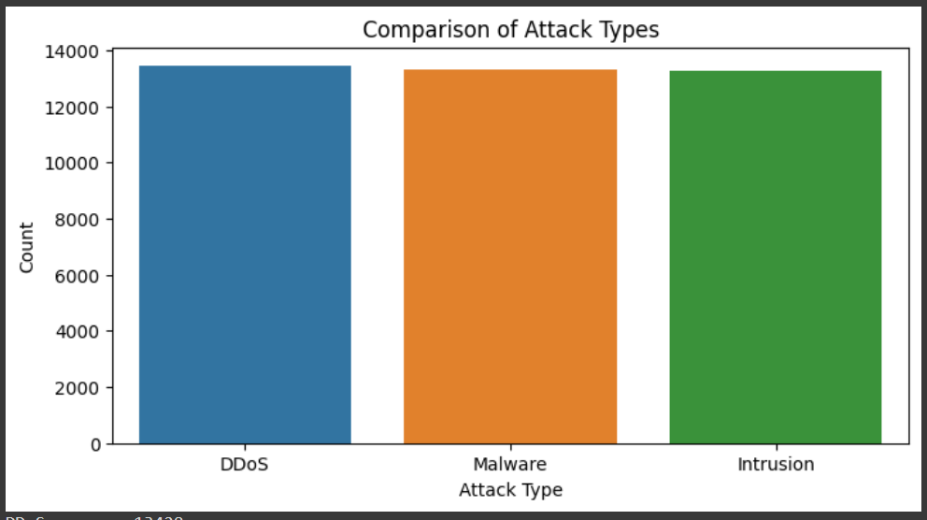
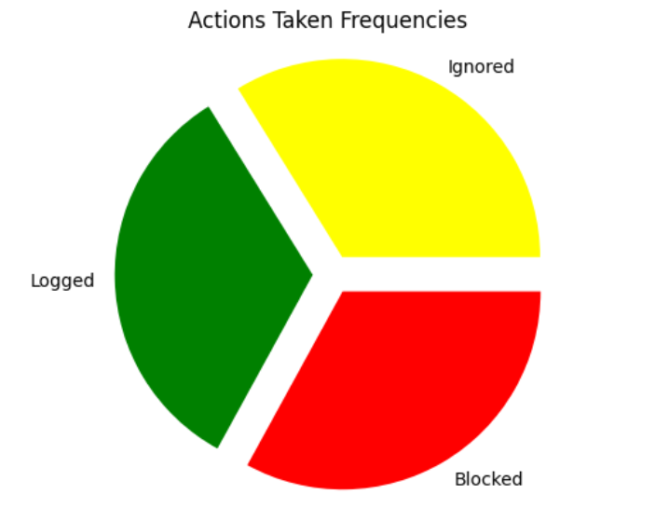
03
Data Visualization

Slide 7
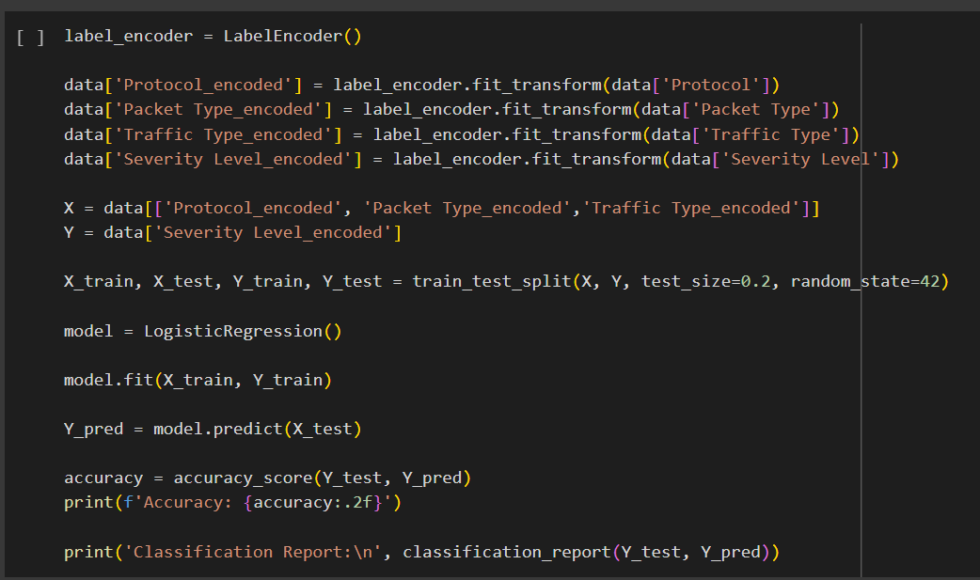
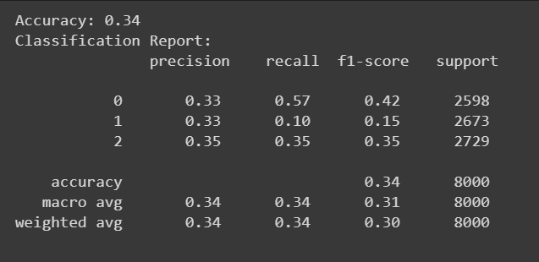
Classification
04

Slide 8
05
Outcome
This project contributes to the ongoing efforts to fortify digital defenses against cyber threats. By developing a severity analysis model, organizations can enhance their ability to identify, assess, and respond to cyber-attacks with precision and efficiency. The insights gained from this project can inform the design of proactive cyber security measures and aid in the development of resilient digital infrastructures.

Slide 9
Thanks!

